Slide 1
Lecture #1
By: Aqib Rehman

Slide 2
outline
React vs React Native
React Intro
How React works
React setup
React Components
State

Slide 3
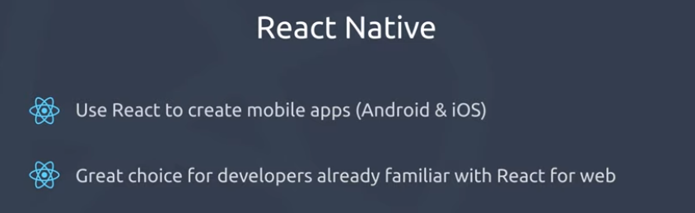

Slide 4
React
React: A Front-end Development Library
React, or ReactJs is an open-source JavaScript library used to develop single-page web applications. It’s one of the popular libraries to build UI (front-end) for web and mobile apps. It was developed and backed by Facebook in 2011 and has gained popularity since then.
Notes:
https://radixweb.com/blog/react-vs-react-native#react

Slide 5
React uses the Virtual DOM to create amazing UX, while React Native leverages APIs to render UI components that can be used again for both Android and iOS platforms.

Slide 6
react native also used:
Core components of React
i.e. Functional Components, States, Props
React Hooks and Context
JavaScript Basic Fundamentals
i.e. objects, arrays, error functions, callbacks
Without JavaScript knowledge not a good place to start

Slide 7
React

Slide 8
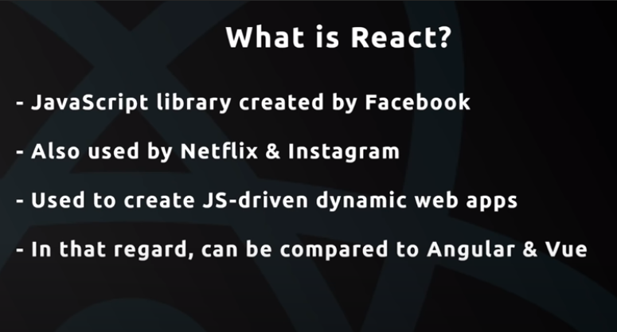

Slide 9
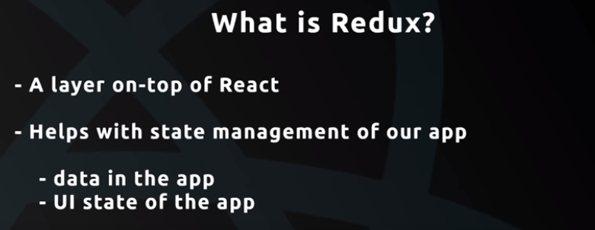
State management means:
Is pop up open or closed
Is menu open or closed

Slide 10
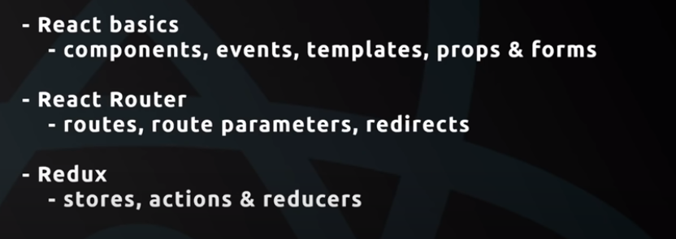

Slide 11
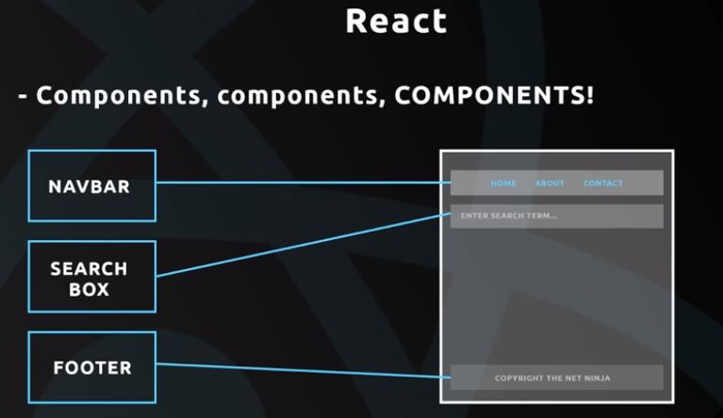

Slide 12
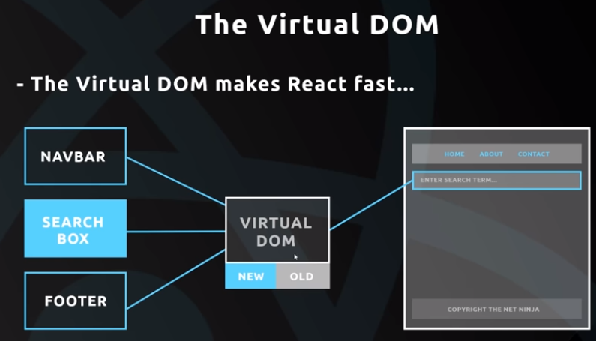

Slide 13
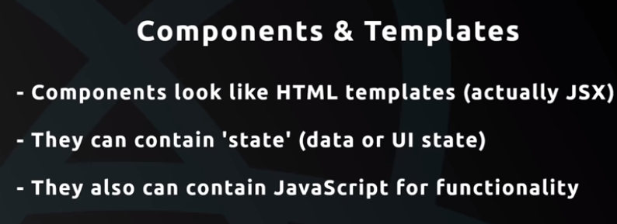

Slide 14
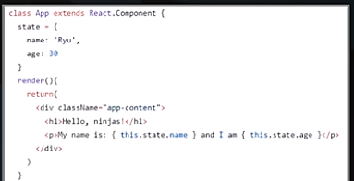

Slide 15
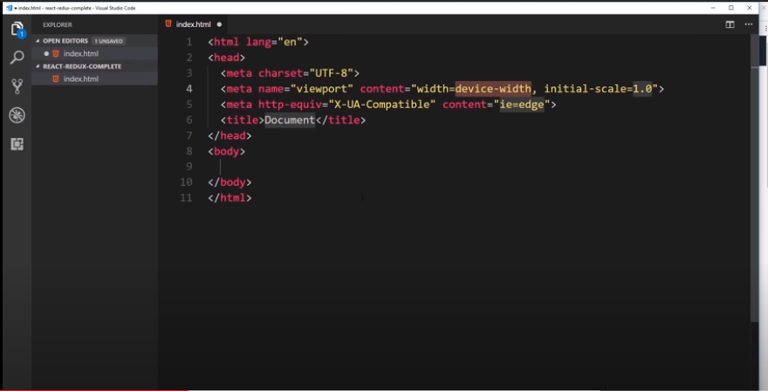

Slide 16
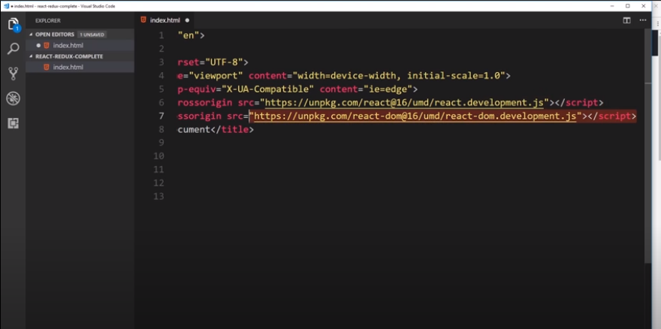

Slide 17
<script crossorigin src="https://unpkg.com/react@18/umd/react.development.js"></script>
<script crossorigin src="https://unpkg.com/react-dom@18/umd/react-dom.development.js"></script>
+ VS Code editor - https://code.visualstudio.com/

Slide 18
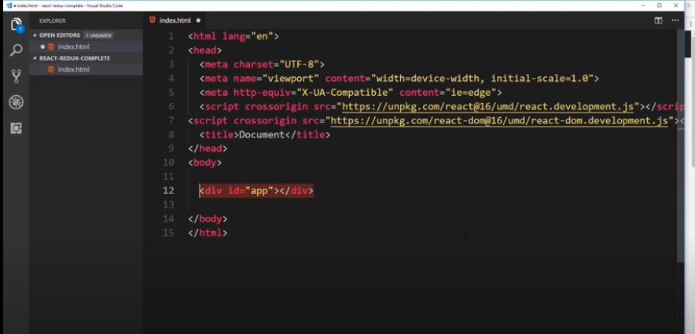

Slide 19
Packages in vs-code

Slide 20
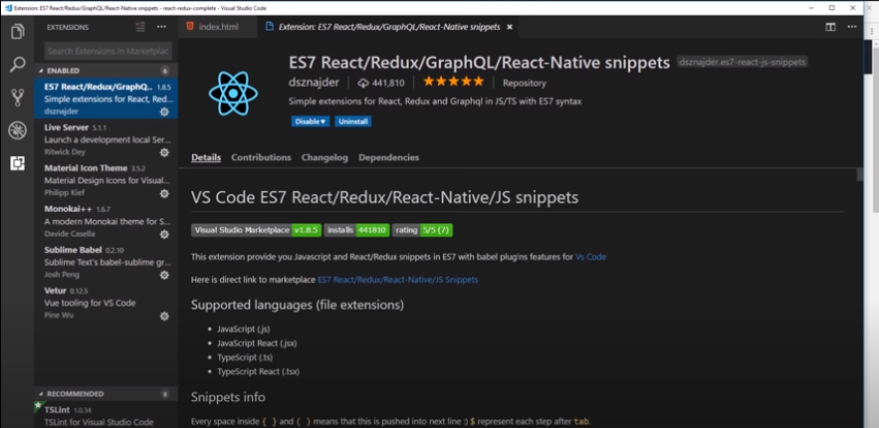

Slide 21
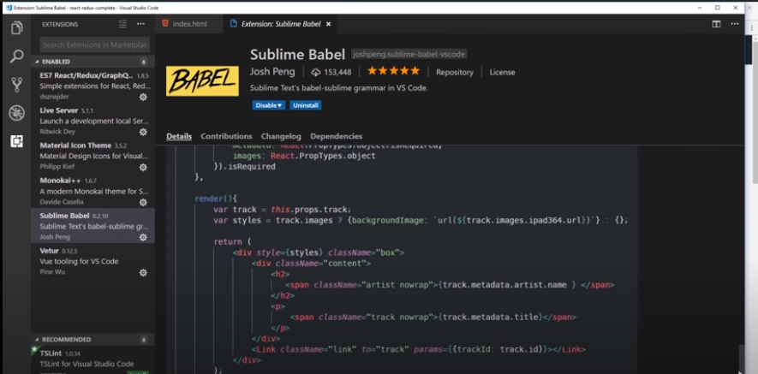

Slide 22
React component

Slide 23
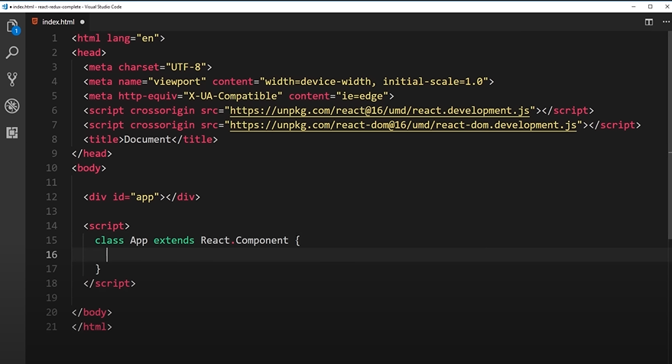
Class based component
React.component= React will be used from React library and React.Component will get all the basics of component

Slide 24
In 2018 conference hooks introduced.
React 16.8.0 is the first release to support Hooks (launch in 2019).
In 2023 new documentation website launch for React 18 and onwards.
https://legacy.reactjs.org/docs/hooks-intro.html
https://react.dev/versions

Slide 25
There are no plans to remove classes from React.
https://legacy.reactjs.org/docs/hooks-intro.html

Slide 26
A class based component must have atleast 1 function that is render

Slide 27
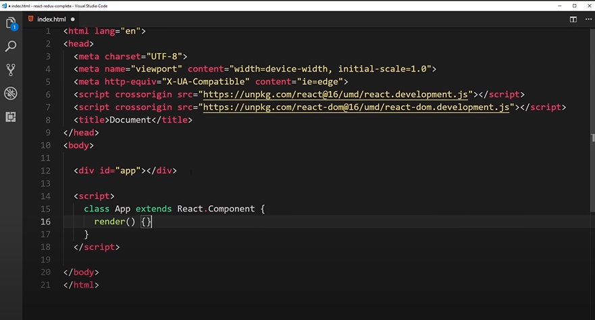

Slide 28
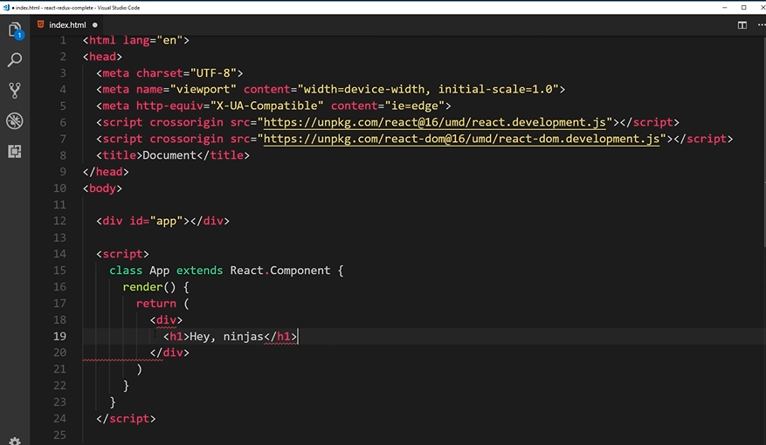

Slide 29
In jsx only one root element can be defined

Slide 30
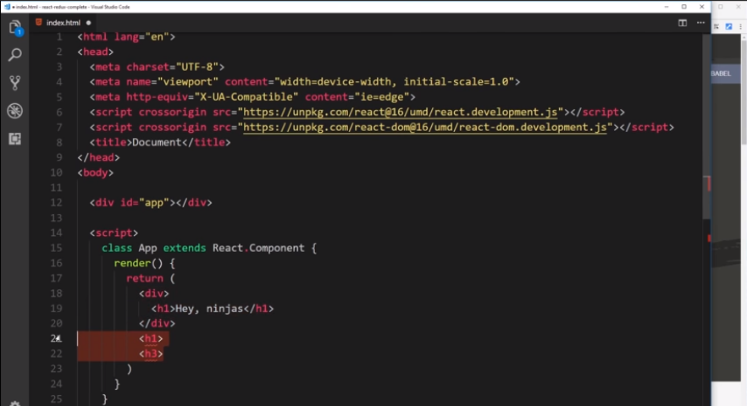
Can’t used like this

Slide 31
Instead of class in javascript we will use classname in jsx

Slide 32
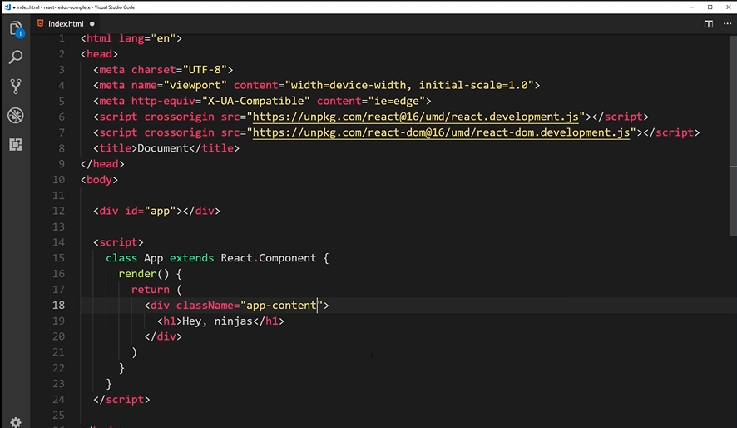

Slide 33
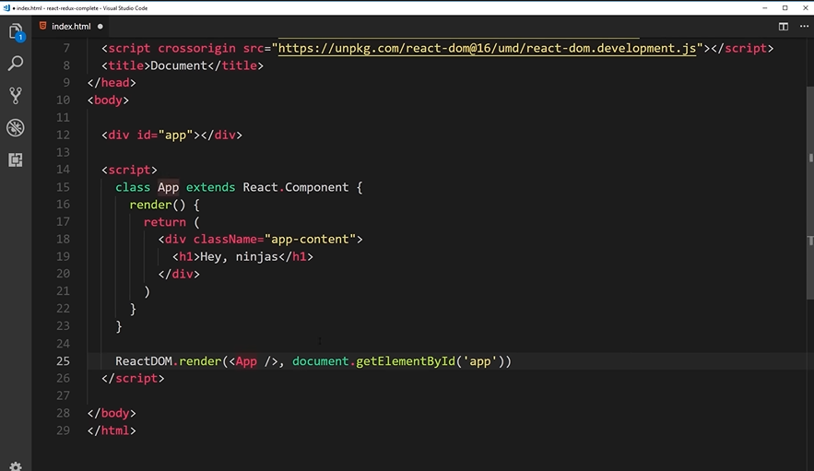

Slide 34
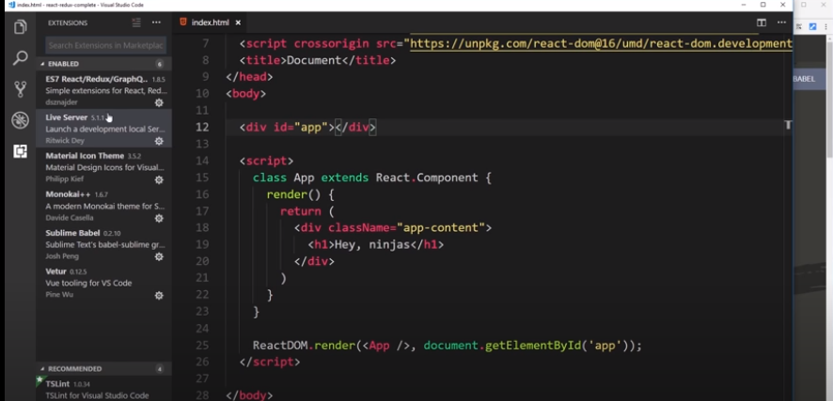

Slide 35
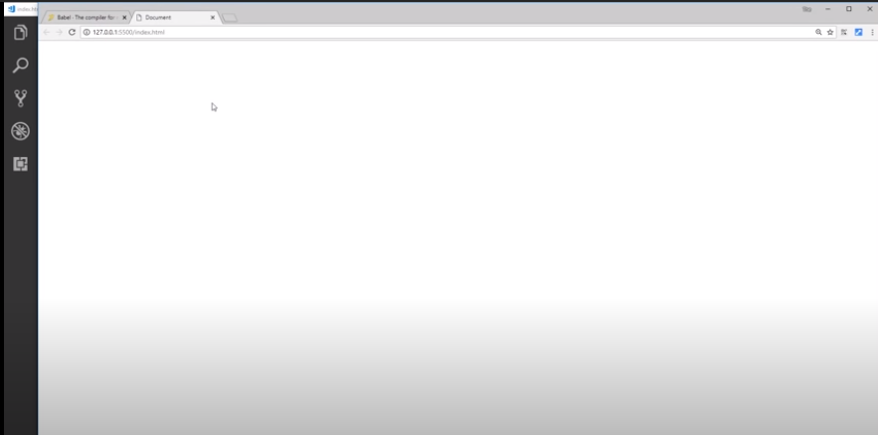
Right click: open in live server

Slide 36
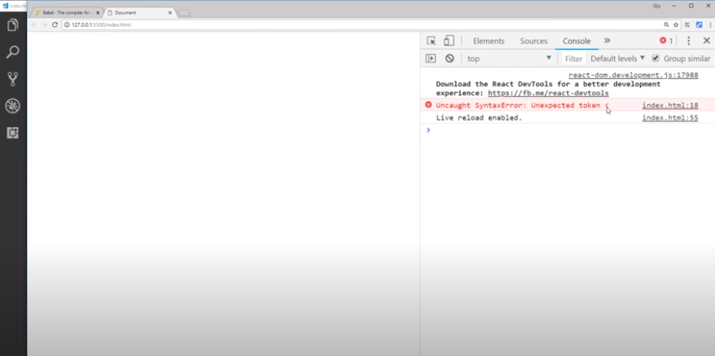

Slide 37
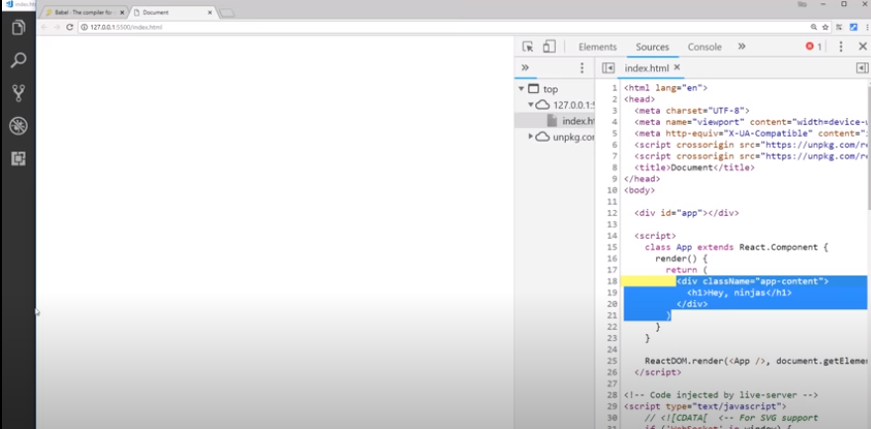
Not understanding jsx: because jsx is not supported in browsers

Slide 38
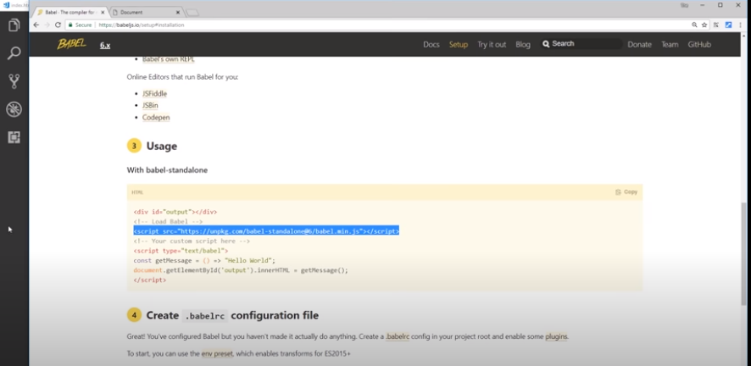

Slide 39
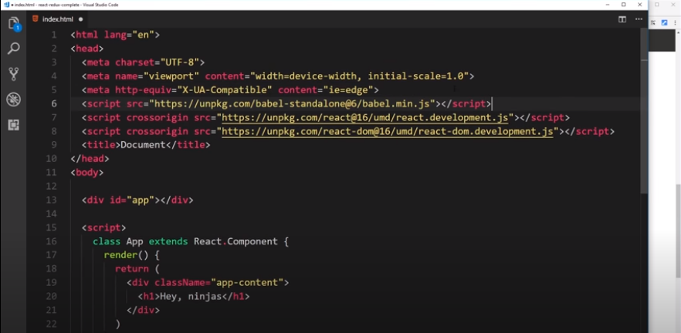

Slide 40
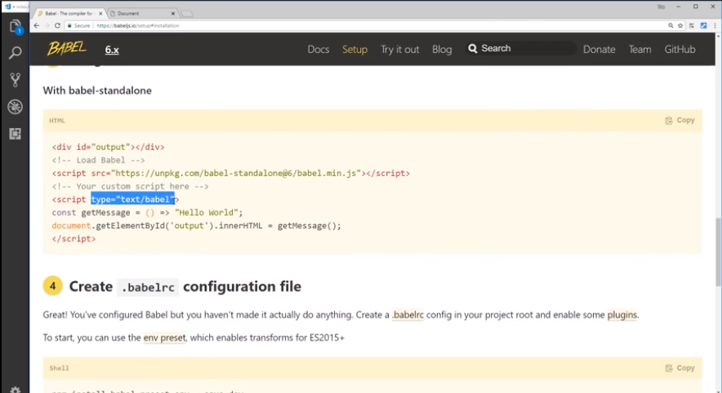

Slide 41
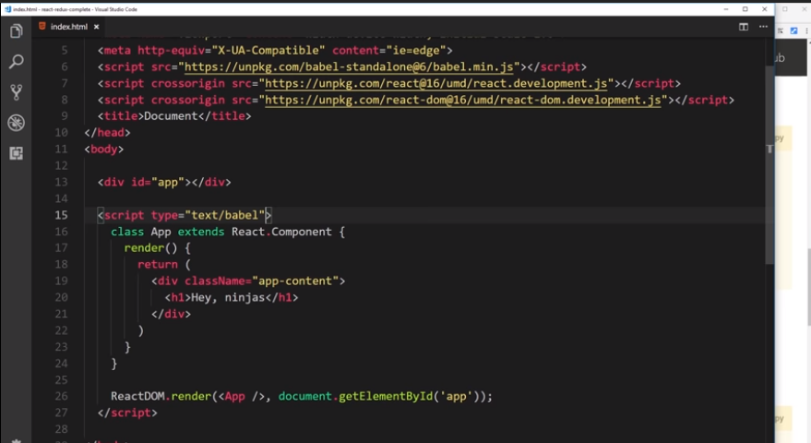

Slide 42
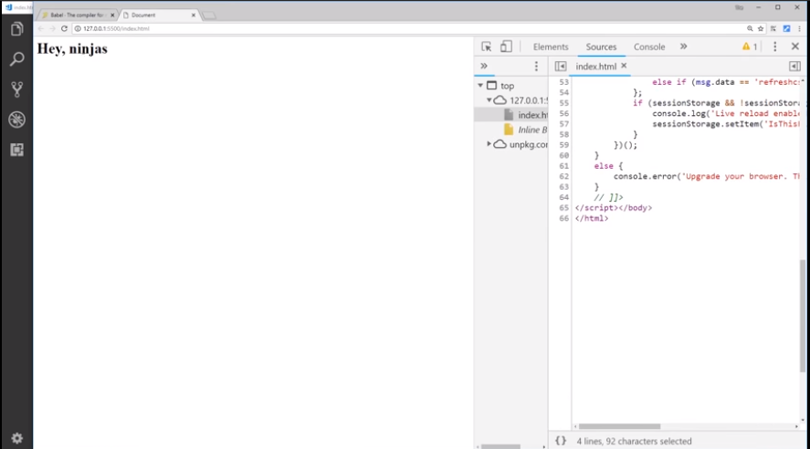

Slide 43
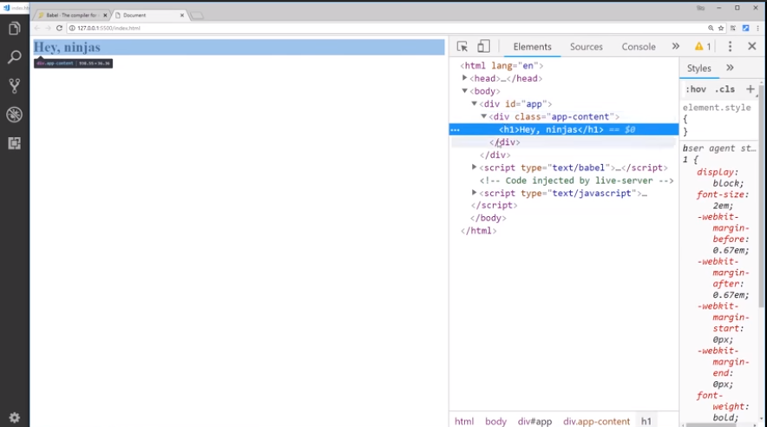

Slide 44
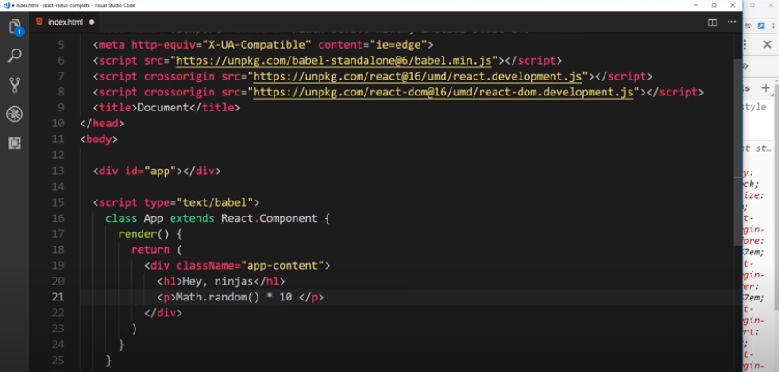

Slide 45
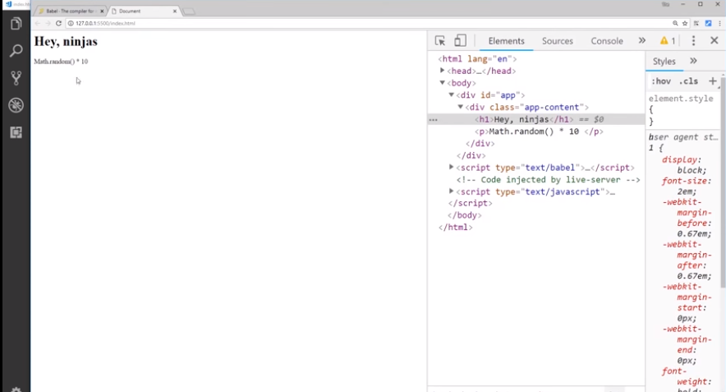

Slide 46
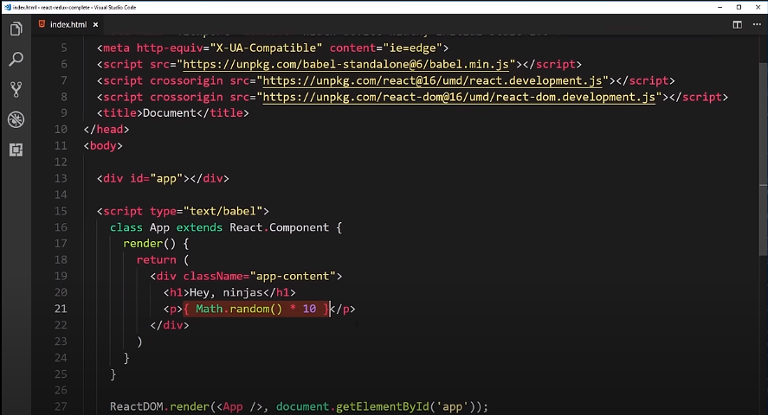

Slide 47
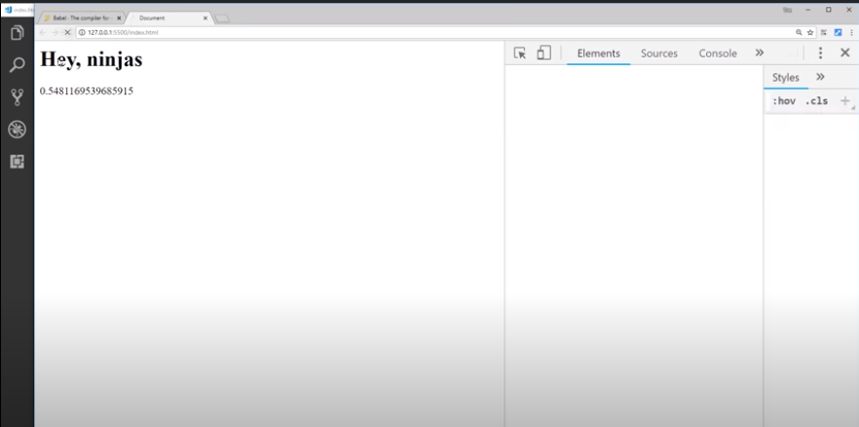

Slide 48
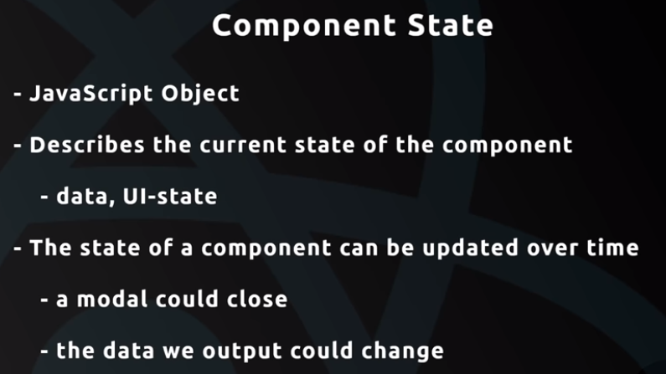

Slide 49
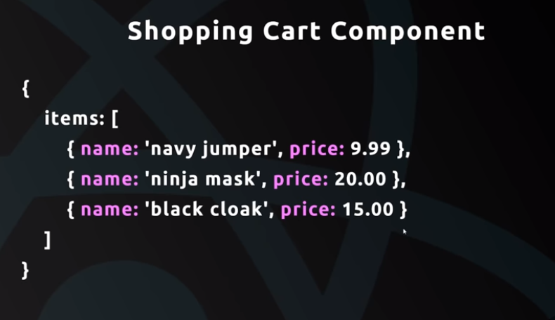
State will be changed if an other item will be added in the items

Slide 50
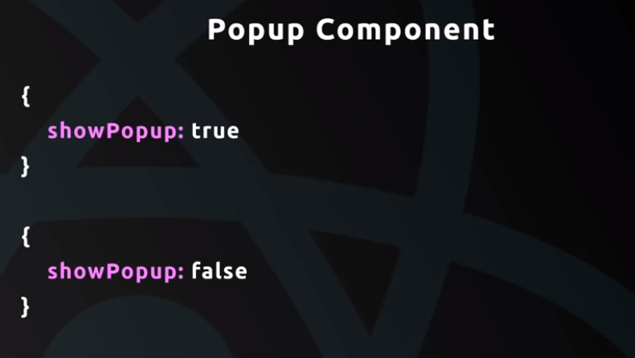

Slide 51
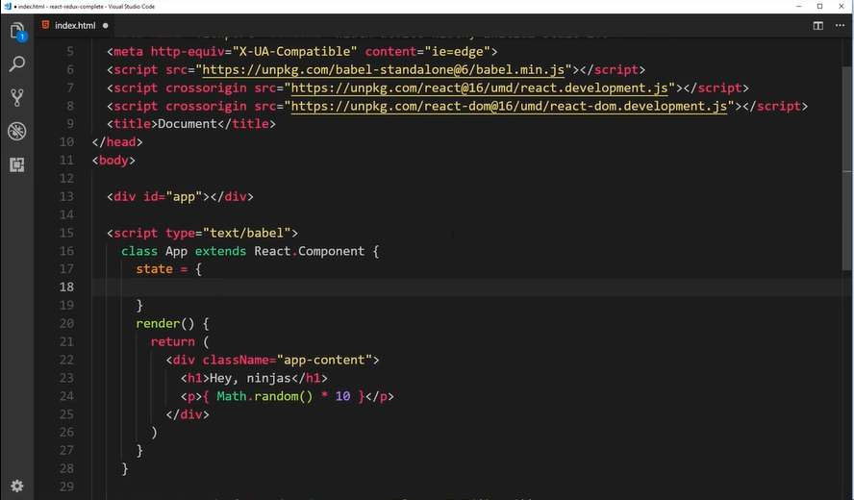

Slide 52
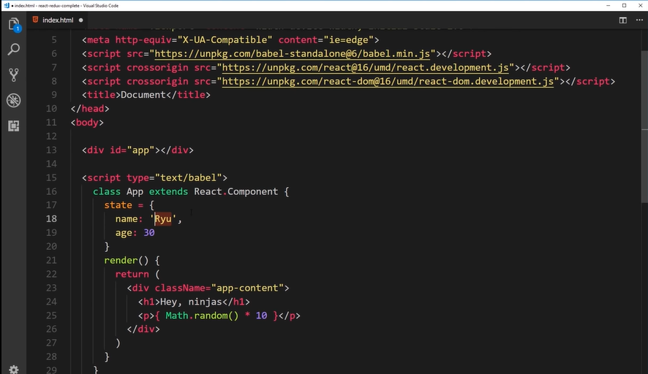

Slide 53
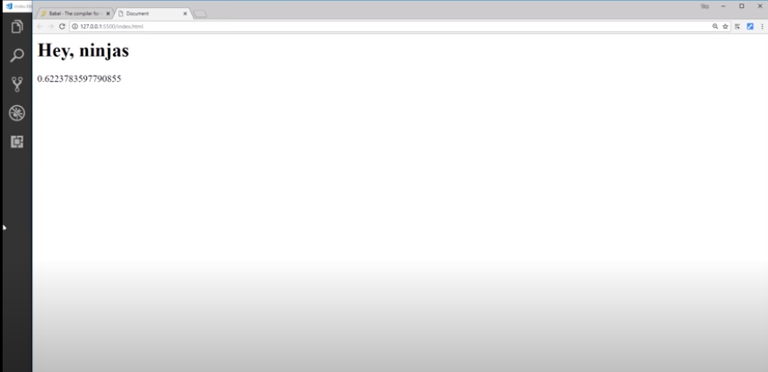

Slide 54
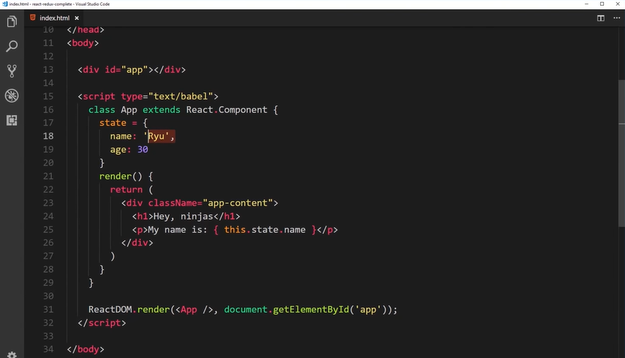

Slide 55
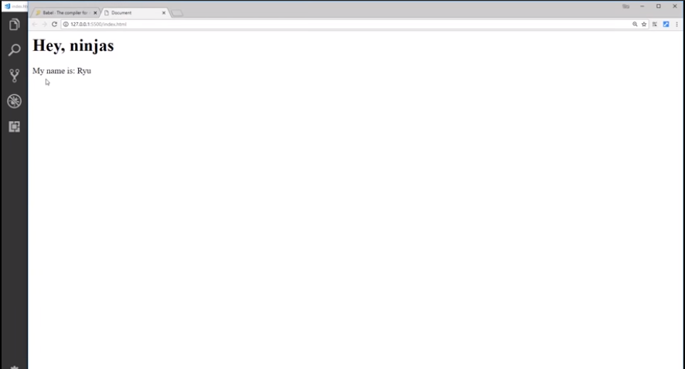

Slide 56
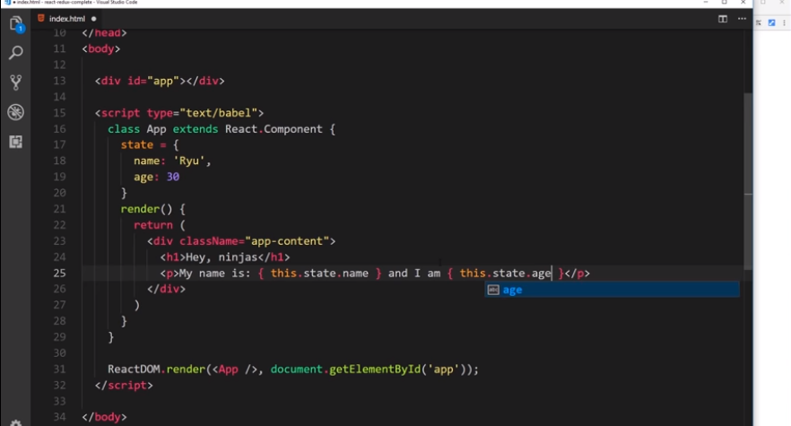

Slide 57
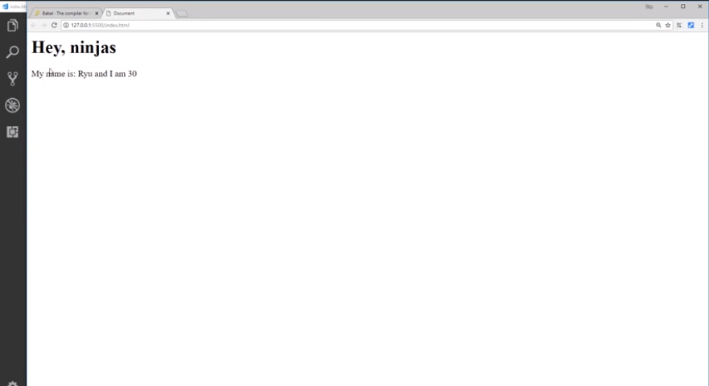

Slide 58
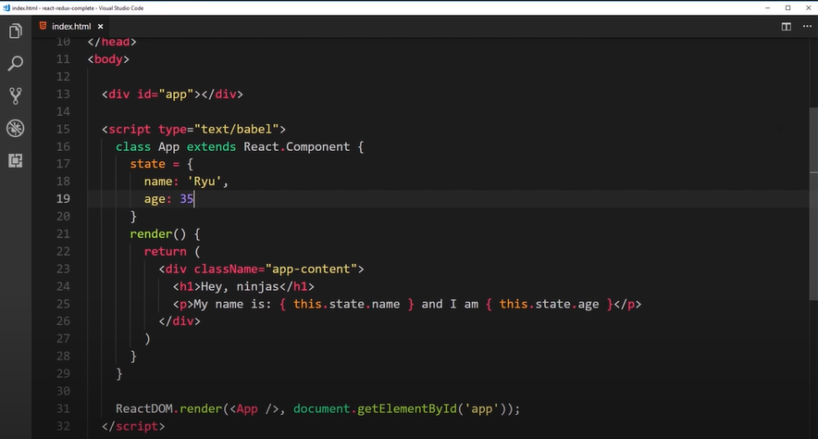

Slide 59
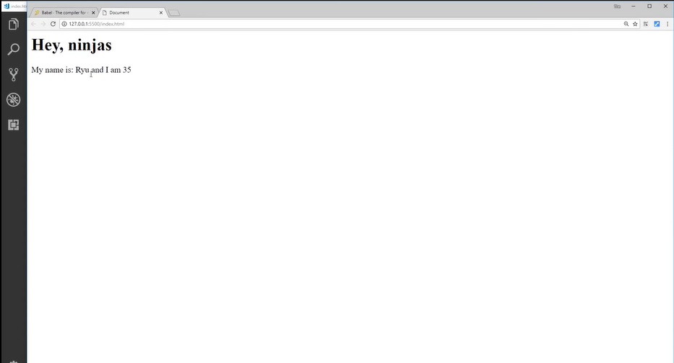

Slide 60
Whenever a state will be changed a data will be changed in the UI

